Slide 1
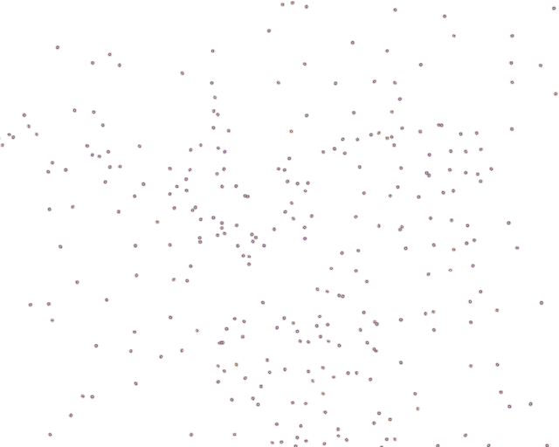
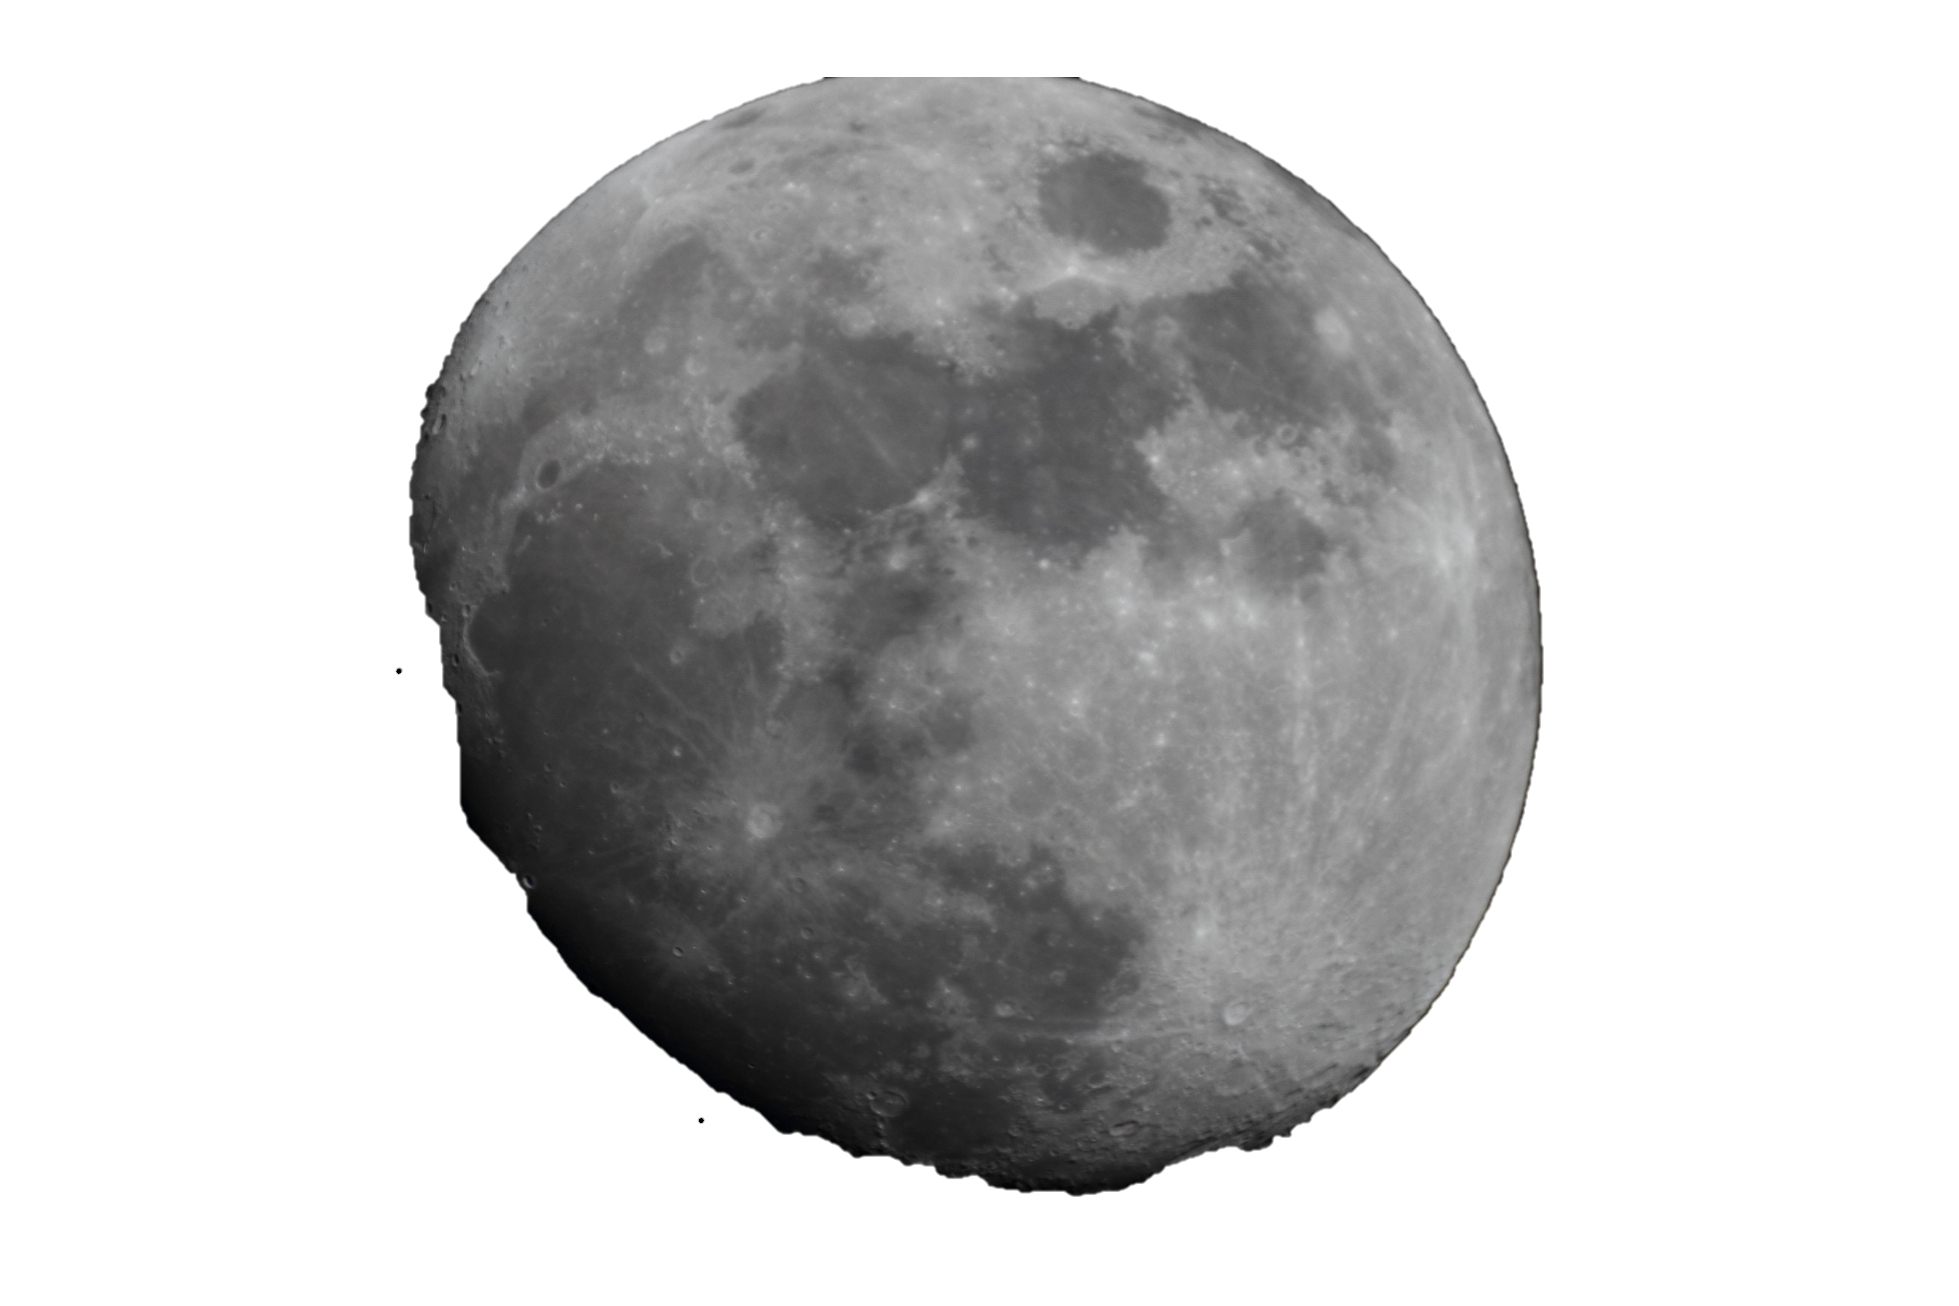
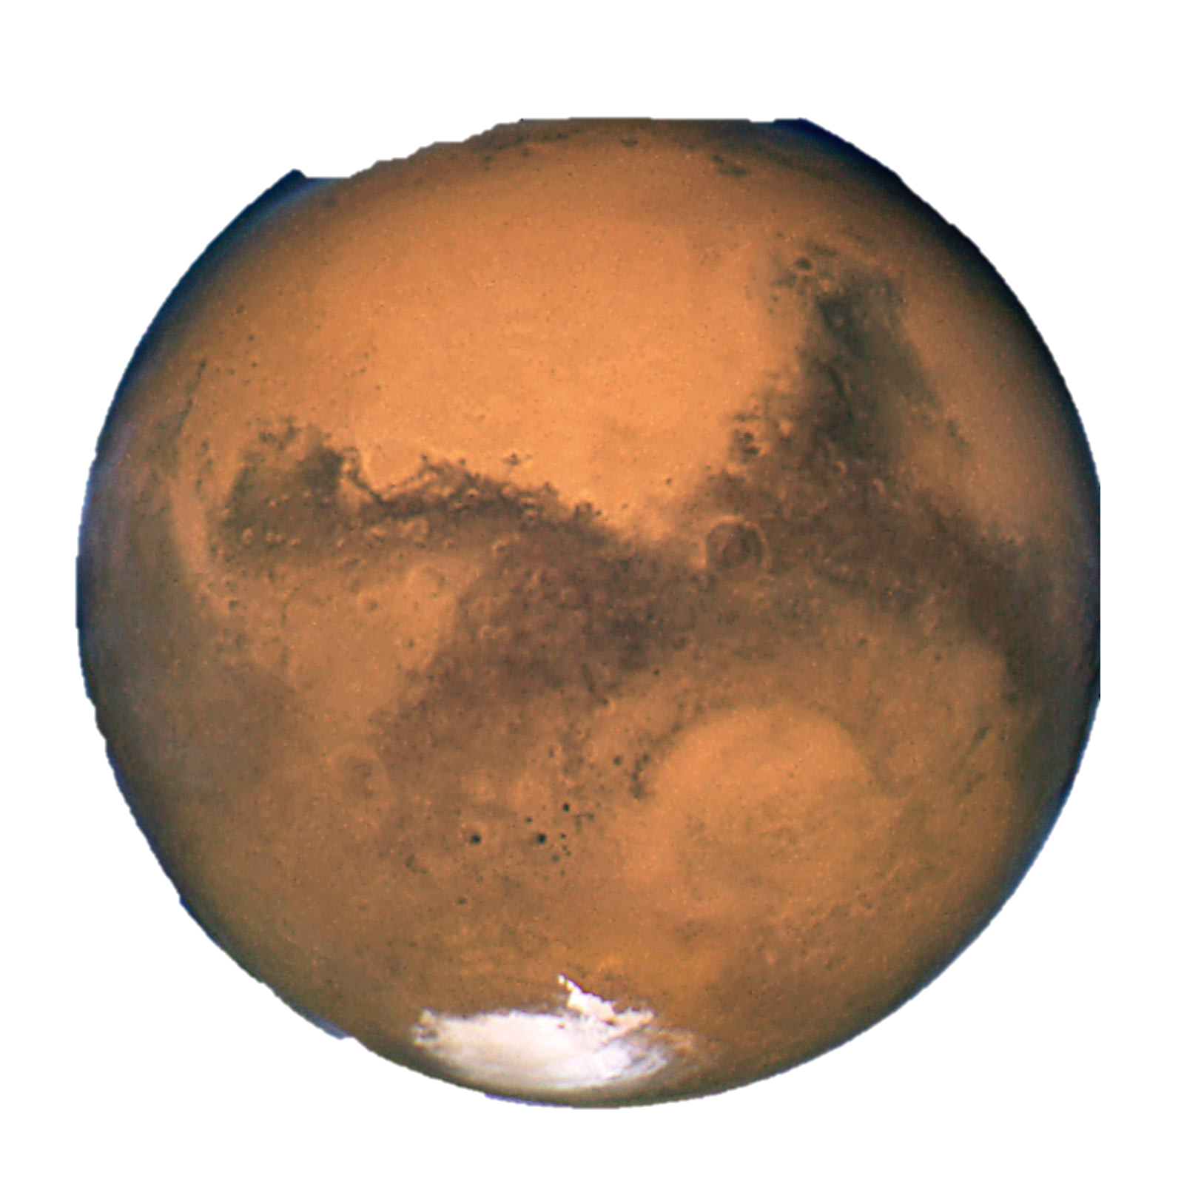
Your home in space
The habitat layout creator

Slide 2
Apollo 26 members:
Team leader:Salma Dorghan
Strategic partner:Hala Hani
Graphic designers:Mohammed Mahmoud, Sarah Munif
Programmers:Noor Alenize, Lamiaa Khairy

Slide 3
Astrohabitat is an interactive 3D experience built with Unity that allows players to explore what living on the Moon might feel like. Set within a semi-realistic lunar environment, players can freely walk through a futuristic habitat designed for NASA’s Artemis-era missions. The game blends scientific realism with immersive exploration, offering a glimpse into how astronauts could live, sleep, and work beyond Earth.
What is astrohabitat about ?

Slide 4
The table that follows shows how the point system divided in our game , four sectors each sector has different ways to gain points to fulfill the full score.
Oxygen | power | comfort | Food and water | total
Oxygen tank(+25) | Solar Panels(+20) | Furniture (chairs, beds) (+15) | Food Storage / Pantry (+20) | ?/100
Plants(varies +2/4) | Batteries / Generators(+5) | Decorations / Paintings(+10) | Water Tanks / Reservoirs (+20) | ?/100
Fans and airconditiong(+2/4) | Wind / Thermal Unit(+10) | Windows/skylights(+5) | Hydroponic Plants / Garden (+15) | ?/100

Slide 5



Tools & Technologies
Unity Used to build and design the entire game environment. It allows players to interact, drag and drop objects, and simulate life on the Moon or Mars.
C# (C-Sharp) The main programming language used in Unity to control the game’s logic — such as oxygen levels, comfort points, and survival scoring.
Visual Studio Code A lightweight code editor used for writing and debugging C# scripts efficiently.

Slide 6
C
O
N
C
L
U
S
I
O
N
This project is more than just a game it's an interactive scientific experience that reflects the real challenges humans will face as they move toward settling in space
By combining realistic design, scientific knowledge, and 3D simulation technology, we aim to deliver a unique model that inspires future generations and transforms the dream of a "home in space" into an achievable reality. .The game is supposed to test your building skills to develop a safe home on the moon or mars with all the requirements whether its oxygen comfort food or power. Unfortunately because of the lack of time and experience we weren’t able to develop the game.

